Slide 1
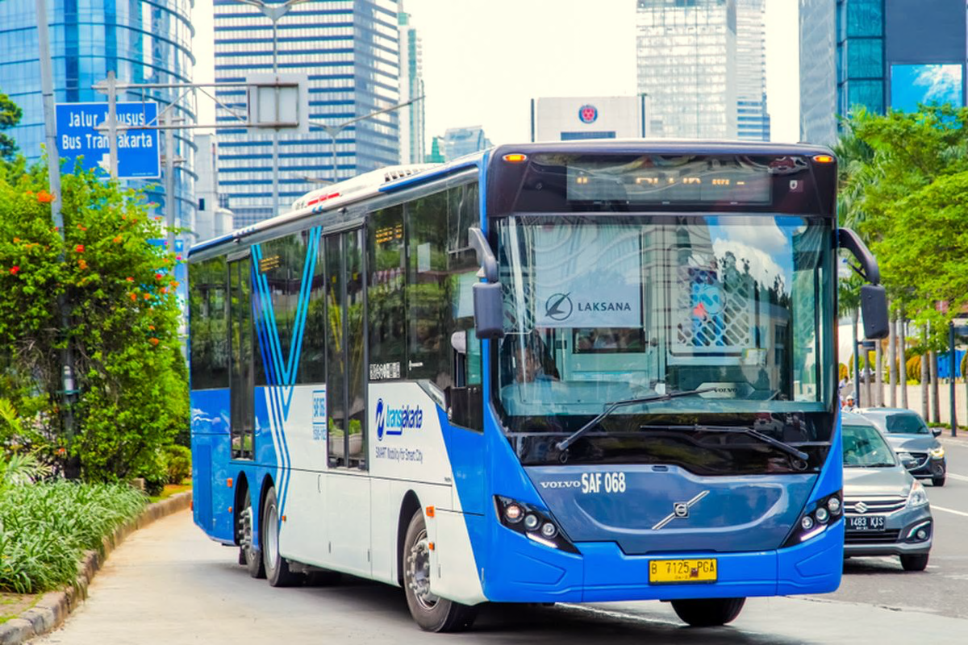
Optimizing Peak-Hour Operations Through Passenger Mobility Analysis
Transaction – level analysis of TransJakarta smart card data – April 2023
Primetta Tatiana
JCBDAAH-005

Slide 2
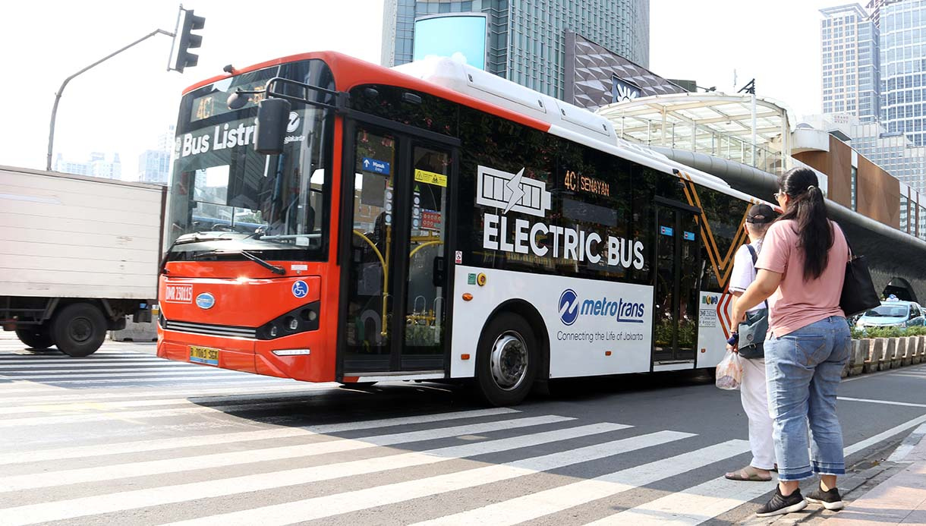
Table of Contents
Executive Summary
Problem Statement & Objectives
Dataset Description
Data Preprocessing
Traffic Generation Analysis
Peak Hour Analysis
Conclusion & Insights

Slide 3

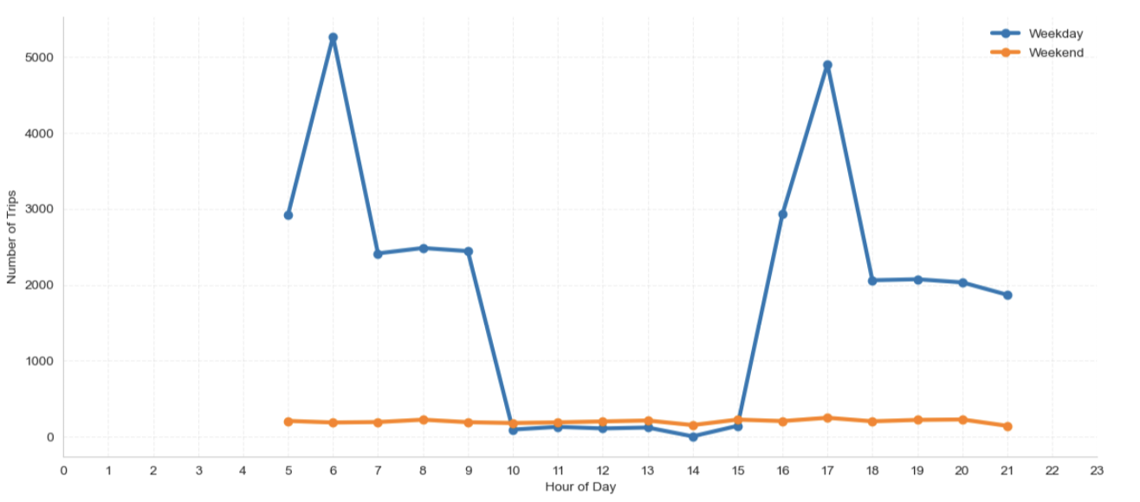
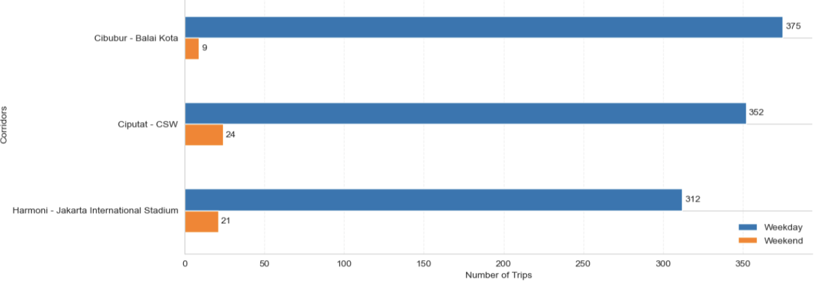
1: Passenger demand is heavily concentrated during weekday commuting periods, creating significant pressure on several TransJakarta corridors
Demand concentration…..
… resulting in uneven operation load across the network
Weekday traffic exhibits sharper commuting spikes, while weekend demand is more evenly distributed.
Peak-hour behavior
Passenger traffic spikes significantly during:
06:00 – 09:00
17:00 – 19.00
Weekday dependency
Weekday travel pattern are significantly more concentrated compared to weekend mobility behavior.
Corridor Pressure
Several corridors face significant passenger concentration during peak commuting hours.
The sharp weekday-weekend gap indicates strong commuter dependency across several high-demand corridors.
Mobility flow
Passenger movement patterns indicate strong commuting flow toward city centers; business and activities

Slide 4
2: Increasing urban mobility demand requires more adaptive and data-driven public transport operations
Urban mobility faces several challenges…
The analysis aims to identify peak demand behavior and generate operational insights for service optimization
Peak-hour congestion creates pressure on public transport infrastructure → leading to overcrowded bus which may lessen bus’s life period.
Passenger demand behaviors are evaluated through four analytical stages
High population density drives substantial daily commuter movement → which makes traffic in central business area prone to congestion which costs time and money.
1.
Data Preparation
2.
Exploratory Analysis
Importance for TransJakarta…
3.
Peak Hour Analysis
4.
Operational Insights
Due to importance of reliable public mass transport, data driven operational planning is essential to allow efficient fleet allocation and support more effective transit management.

Slide 5

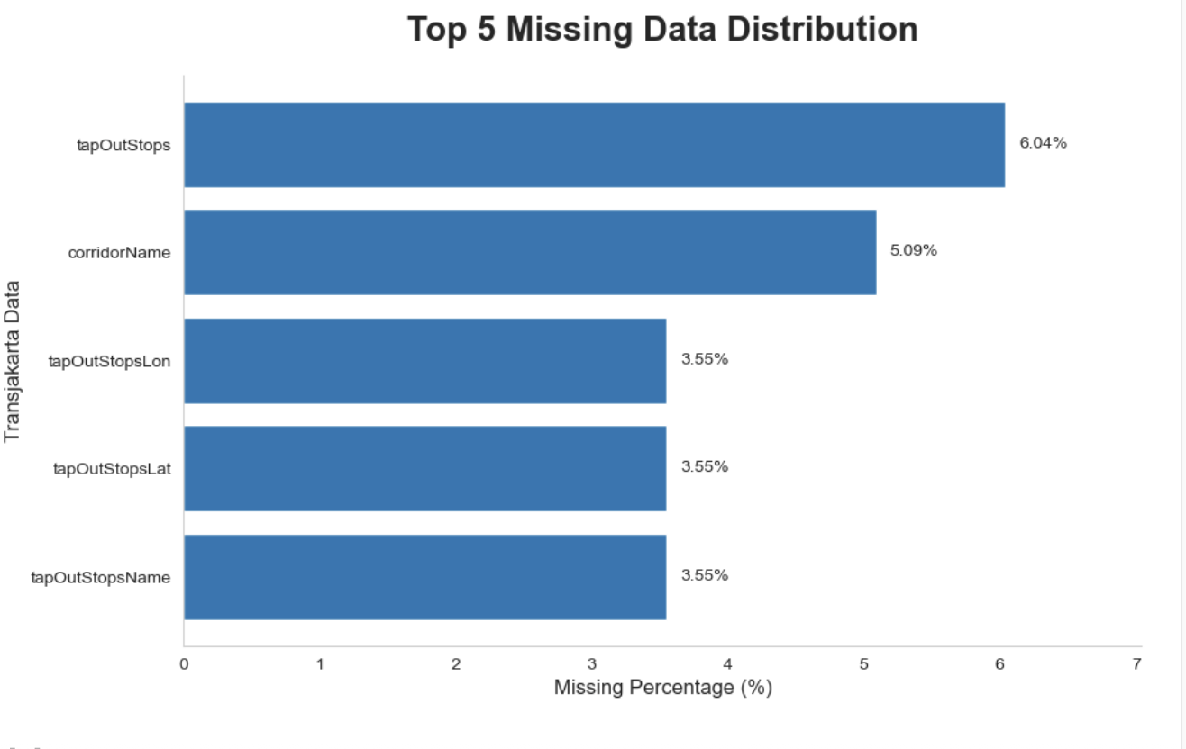
3: The Dataset Captures Mean of 1,263 Daily Passenger Transaction Activity Across Multiple TransJakarta Corridors Transaction-level TransJakarta passenger mobility data taken on April 2023.
The largest missing values are associated with tap-out data, indicating potential errors in the tap-out machine system.
37k+
Transactions
30
Observation Days
23
Data Features
14k+
Missing Values
5

Slide 6
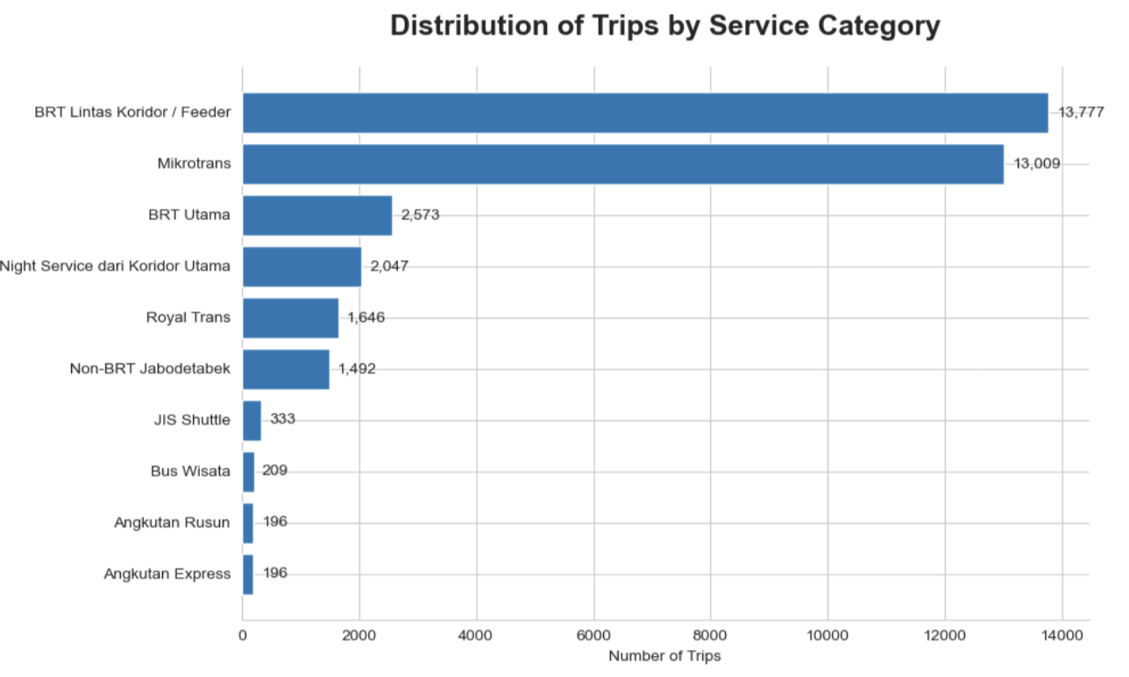
4: More than 35k+ cleaned transaction records were validated and prepared for reliable operational and mobility analysis
Operational Coverage Overview
… in which trips are divided by 10 TransJakarta services categories
Data Cleaning Flow
Missing Value
Passenger trips are heavily concentrated on cross-corridor BRT and mikrotrans services which shows dependency on integrated connectivity beyond primary BRT corridors.
3,5k+
Bus Stops
Datatype Conversion
Feature Engineering
221
Corridors
Data Validation
6.39%
Invalid Records
Removed
1,1k+
Average Daily Trips
Inter-Corridor BRT ex. 8C: Kebayoran Lama – Tanah Abang
Mikrotrans ex. JAK.06: Kampung Rambutan – Pondok Gede

Slide 7
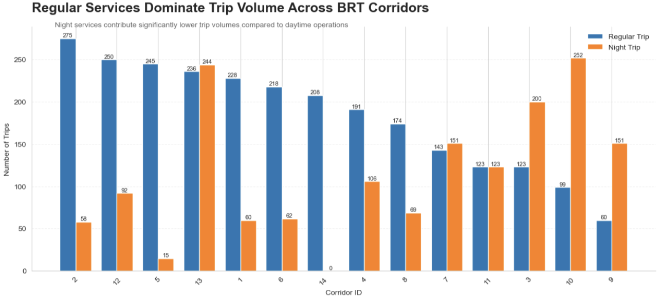
5: 94.2% of Passenger Trips Occur during Regular BRT operations, highlighting strong dependence on daytime corridor services.
BRT corridor operation are categorized into Regular Trip and Night Trip services based on corridor services code.
Night services operate at considerably lower trip volumes across most corridors.
Corridor 2, 12, and 5 record the strongest regular-trip dominance.
Selected corridors such as Corridor 10 and 13 exhibit comparatively higher night-service utilization.

Slide 8
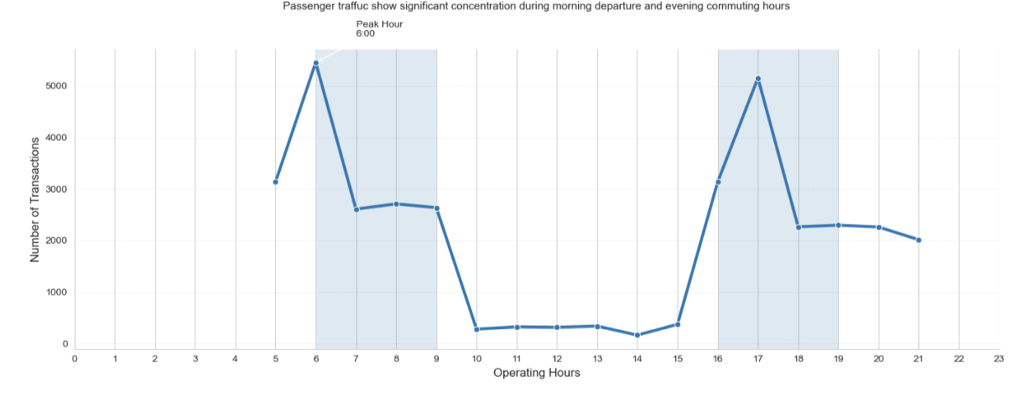
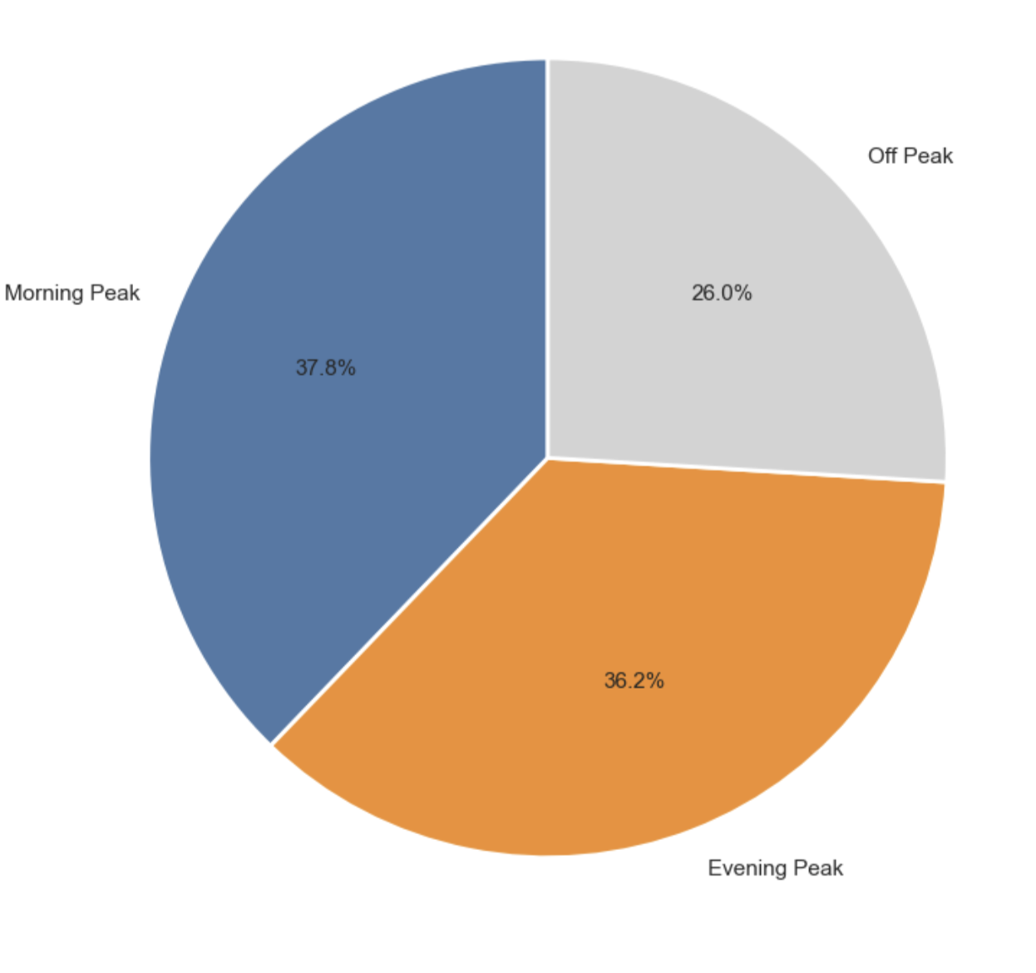
6: Passenger Demand is Highly Concentrated in Morning and Evening Peak Periods, Accounting for 74% of Total Transaction
Peak-hour demand dominates TransJakarta passenger movement patterns.
Transaction volume surge significantly during morning departure hours and return commutes.
38%
Morning Peak
36%
Evening Peak
Morning peak traffic reaches its highest point around 06:00.
Evening demand intensifies again around 17:00.
This number suggest capacity planning to be focused on morning and evening demand surges.

Slide 9
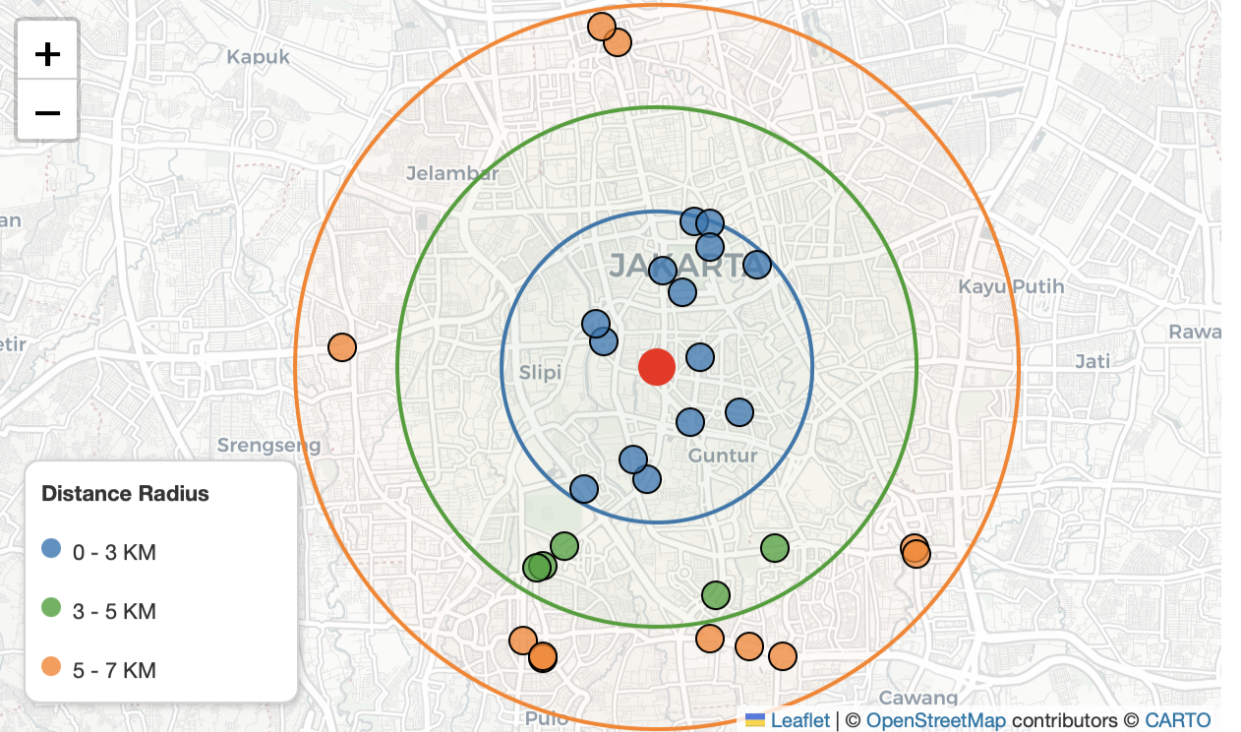
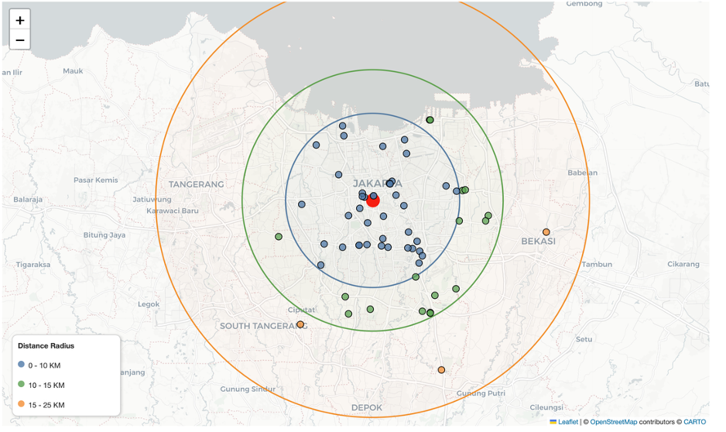
7: Strong Inbound Passenger Movement Toward Central Area During Morning Peak Hour and Vice Versa during Evening Peak Hour
Central Area defines as far of 7 km radius from Bundaran HI
Transjakarta passenger as far as 23 km
Morning Peak Hour
Evening Peak Hour
Direction flow towards central area
Direction flow towards sub-district areas.
Top 3 corridors are coming from sub-district; Ciputat-CSW, Cibubur – Balai Kota, Kampung Rambutan – Pasar Rebo
Top bus stops are Monas, Gelora Bung Karno, Kejaksaan Agung.
12,856
Trips During Evening Peak Hour
Top 3 corridors are coming central area: Balai Kota – Cibubur, Tanah Abang – Kebayoran Lama, Bundaran HI - Kalideres
Top bus stops are BKN, Pinang Ranti, and Summarecon Bekasi.
5,371
Trips Inbound Towards Central Business Area

Slide 10
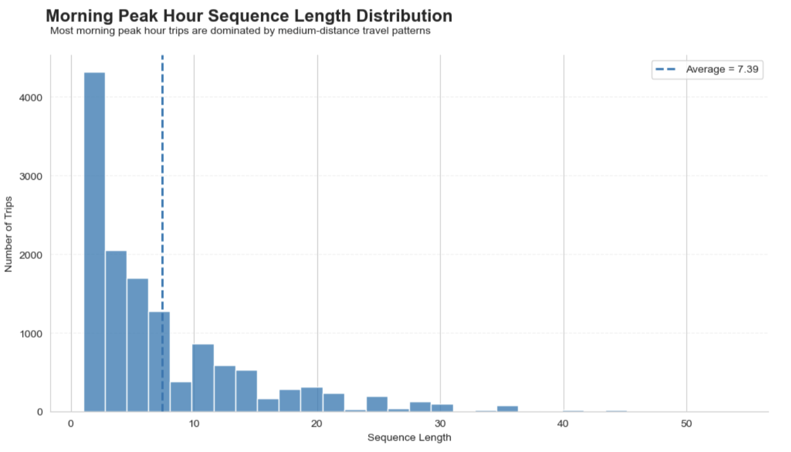
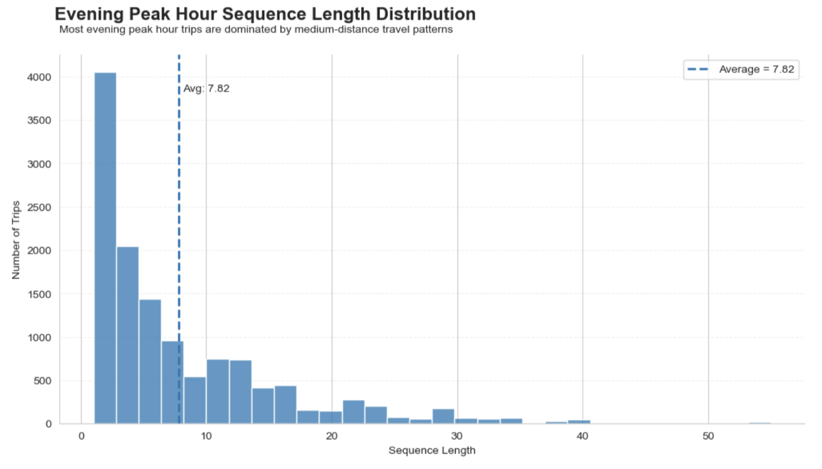
8: Evening peak passengers tend to travel slightly longer distances than Morning peak commuters.
Inisghts:
Passengers are more flexible in their return journeys, potentially relying on TransJakarta for broader end-to-end mobility compared to the more destination-driven morning commute.
Evening trips are slightly longer (+7%).
Both periods remain concentrated in short-to-medium distance travel.

Slide 11
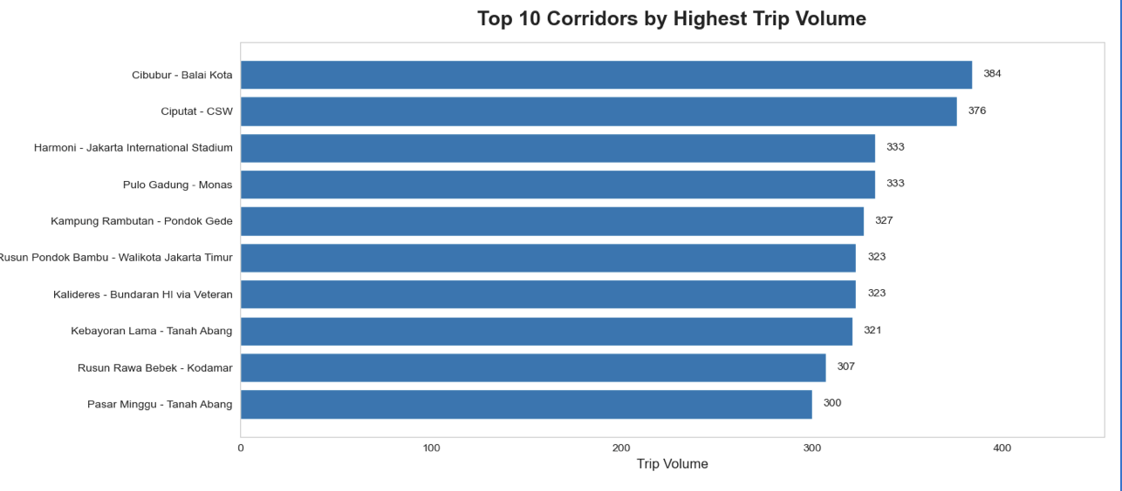
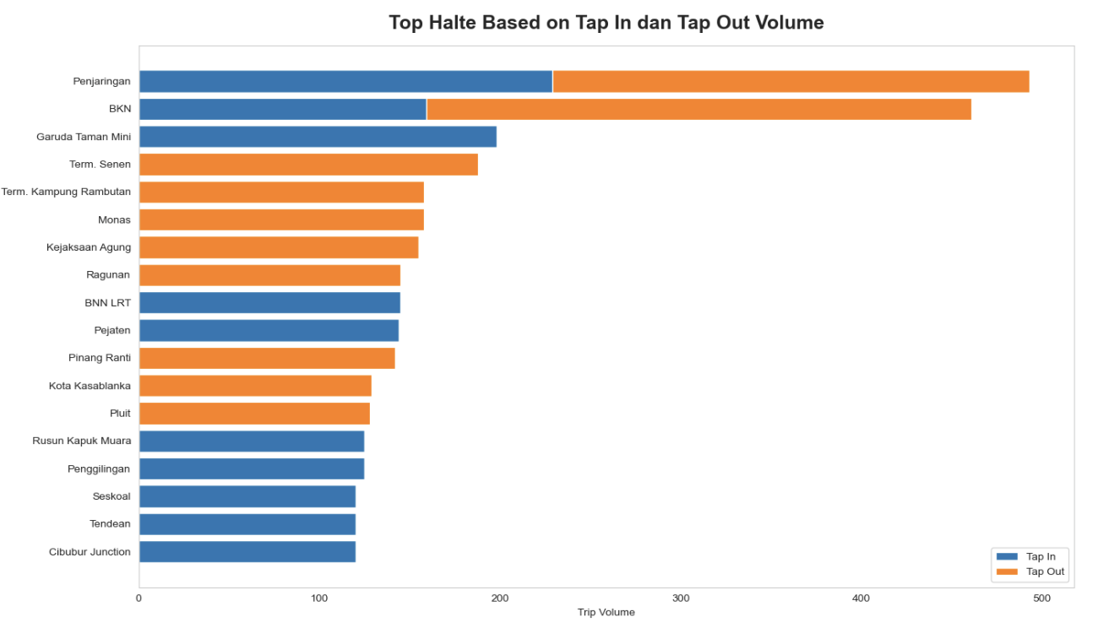
Insights: Passenger concentration patterns reveal opportunities for corridor expansion and multimodal hub development
Corridor & Bus Stops Data allow us to learn…
Top Corridor by Number of Trips
Corridor Expansion Opportunity
The strong passenger concentration observed along the Ciputat–CSW corridor indicates potential demand for expanded TransJakarta connectivity toward the Velbak area.
Enhancing direct corridor integration could reduce transits and increase public transport rideship.
Top Stops by Number of Trips
Potential Mobility Hubs
Penjaringan and BKN show potential as strategic mobility hubs. Penjaringan is a potential hub for West – North Jakarta area and BKN for East Jakarta passenger distribution.

Slide 12
Future TransJakarta network growth will increasingly depend on corridor integration, multimodal connectivity, and strategic hub-based mobility development.
Key Takeaways
Strategic Insights
Jakarta mobility remains highly commuter-driven
Passenger demand is heavily concentrated during morning and evening peak hours, indicating strong dependency for daily work-related mobility.
Corridor expansion and mobility hub development opportunity.
Trips per day shows insightful data on corridors that has opportunities to be expanded and new hub like Penjaringan and BKN.
2. High-demand corridors highlight suburban-to-core connectivity needs
Such as Cibubur-Balai Kota and Ciputat-CSW show high amount of daily trips
2. Operational Optimization Opportunity
Classifying corridors based on trips per day and its type may beneficial to set:
Right Fleet Sizing
Optimizing Headway and Service Frequency Adjustment

Slide 13
Thank you

